Slide 1

Quantitative Research in Political Science How to Apply the Classical Toolbox
Giuseppe Carteny
Postdoctoral Researcher
Department of European Social Research
University of Saarland
UdS SoSe2025 - Class 4 (05.05.2025)

Slide 2
Today‘s seminar
Review of the assignments
Correlation(s)
R programming
Hands-on
Assignment

Slide 3
Review of the assignments

Slide 4
Assignment #1
Did you read?
Resources
Agresti & Finlay (2009) - Chapters 1, 2, 3

Slide 5
Assignment #2
Did you fork and clone the repository?
Did it work? Issues?
Repo
https://github.com/giucarny/qrps_sose25/
Did you check the additional resources I suggested?
What’s the difference between forking and cloning…
Action | Where It Happens | Purpose | Typical Use Case
Fork | On GitHub | Create your own copy of a repository | Contributing to someone else's project
Clone | On your computer | Work on a repository locally | Developing with local tools and environment

Slide 6




Workflow
Pull request
Upstream
Fork/Origin
Sync
Push
Push
Pull
Our local repos
Your local repo

Slide 7
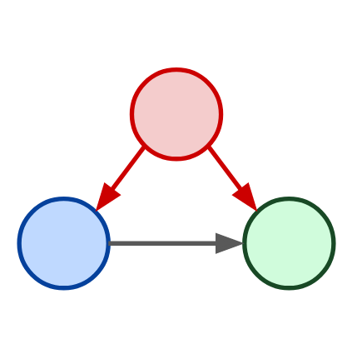
Assignment #3
How is it going with your model?
Your research question?
Your DV from EES2019?
Your “grouping” IV?
Confounder
Independent Variable
Dependent Variable

Slide 8
Correlation & friends

Slide 9
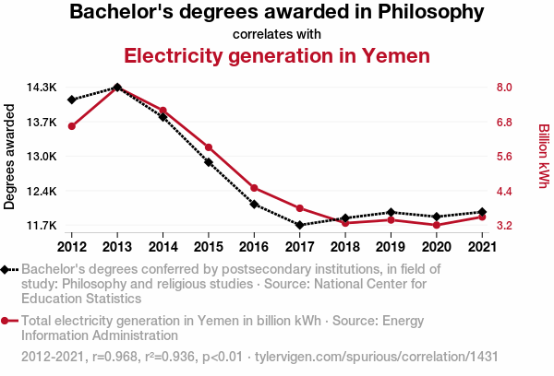

Correlation(s)
When we refer to correlation we usually refer to an association between two variables
The two variable co-vary, namely they vary together
Often the goal of social science is to see whether this correlation is the product of an actual relationship or determined by chance (or unobserved/omitted variables)

Slide 10
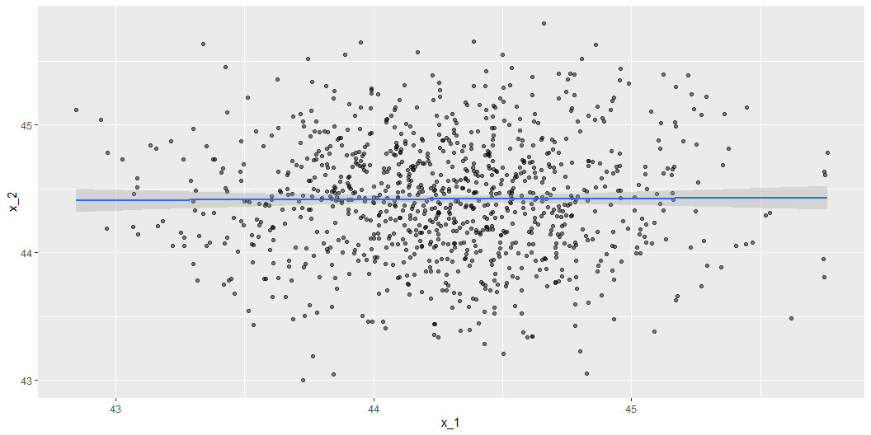
Correlation(s)
When we refer to correlation as a statistical concept, however, we often refer to a very specific kind of correlation, which is the linear correlation
This is by no means the only form of correlation out there! But, it is often used because
most of the times offers (at least at a preliminary stage) a fairly accurate generalisation of the relationship between two variables
crucial in regression analysis – e.g., It is crucial for the generalised linear models (GLMs) family, that we will soon explore
underpins the assumptions and diagnostics of many statistical models.
...
In short, it is at the core of many statistical inference and prediction techniques

Slide 11
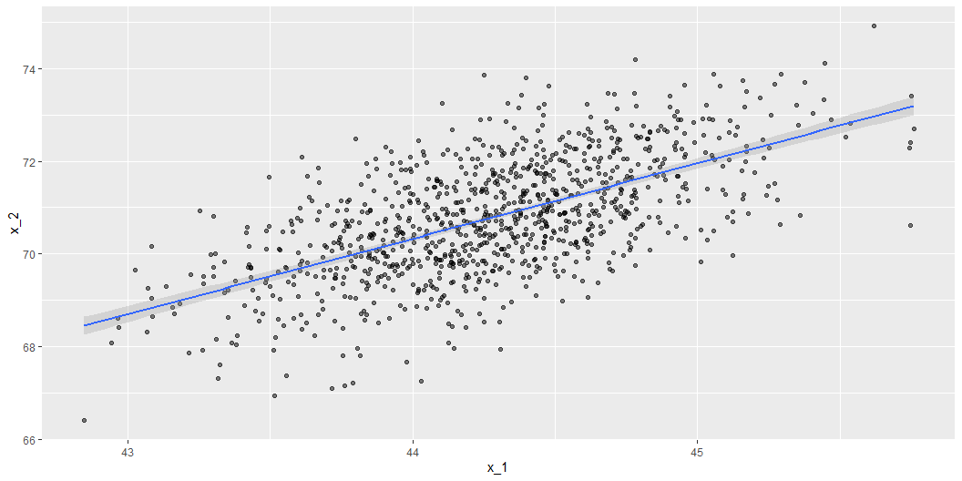
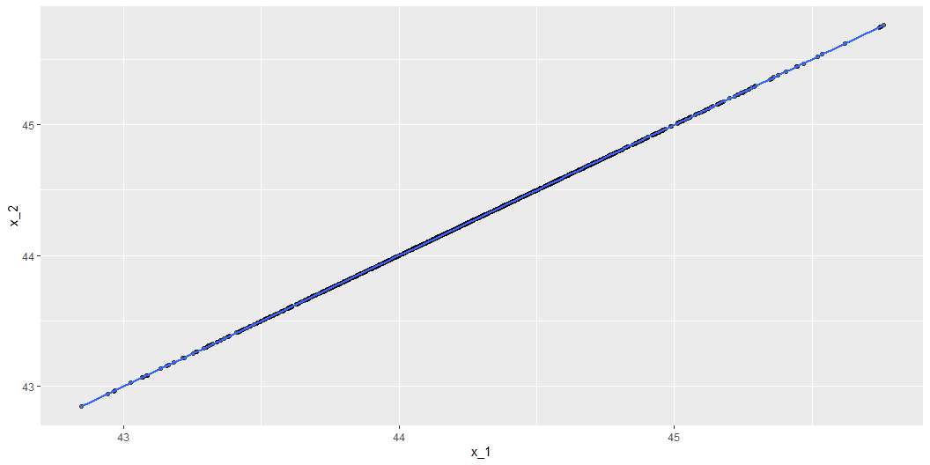
Correlation(s)
It ranges from
-1 (perfect negative correlation)
+1 (perfect positive correlation)
0 indicates no correlation

Slide 12


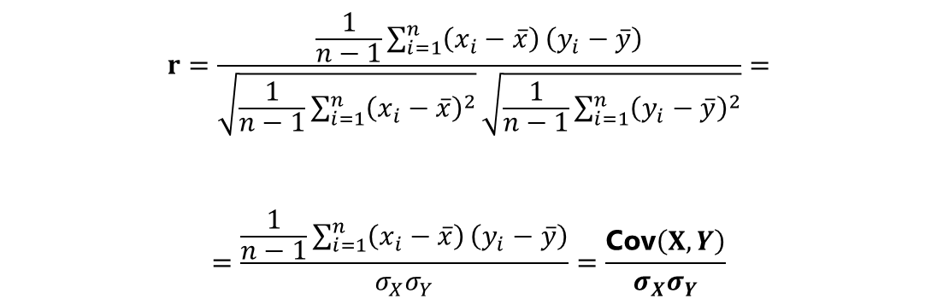

Covariance and correlation
The correlation is a normalised version of another measure that is called covariance
It is literally the joint joint variability of two variables.
Units are the product of the units of X and Y, making it not standardised.
Why it is important to know this?
Because variance and covariance are the component of a fundamental block of any regressio model, namely the variance-covariance matrix
$$σ=\sqrt{\frac{1}{n−1}\sum_{i=1}^{n}{{\left(x_{i}−\overset{‾}{x}\right)}^{2}}}$$
$$σ^{2}=\frac{1}{n−1}\sum_{i=1}^{n}{{\left(x_{i}−\overset{‾}{x}\right)}^{2}}$$
$$\text{Cov}\left(X,Y\right)=\frac{1}{n−1}\sum_{i=1}^{n}{\left(x_{i}−\overset{‾}{x}\right)}\left(y_{i}−\overset{‾}{y}\right)$$
$$r=\frac{\frac{1}{n−1}\sum_{i=1}^{n}{\left(x_{i}−\overset{‾}{x}\right)}\left(y_{i}−\overset{‾}{y}\right)}{\sqrt{\frac{1}{n−1}\sum_{i=1}^{n}{{\left(x_{i}−\overset{‾}{x}\right)}^{2}}}\sqrt{\frac{1}{n−1}\sum_{i=1}^{n}{{\left(y_{i}−\overset{‾}{y}\right)}^{2}}}}=$$
$$=\frac{\frac{1}{n−1}\sum_{i=1}^{n}{\left(x_{i}−\overset{‾}{x}\right)}\left(y_{i}−\overset{‾}{y}\right)}{σ_{X}σ_{Y}}=\frac{\text{Cov}\left(X,Y\right)}{σ_{X}σ_{Y}}$$

Slide 13
R programming

Slide 14
Checkpoint
This is also an hands-on session so...
Git & Github
(1) Sync your fork/orogin (2) pull your fork/origin
RStudio
Open the script ~/scripts/class4/class4_ees.R

Slide 15


Data: European Election Study
Today we will work with the European Election Study (EES) voter study of 2019.
The EES is a series of cross-national research projects, initiated in 1979, to analyse electoral behaviour and political attitudes in the context of European Parliament (EP) elections.
Several components: surveys, manifestos, elite surveys, mass media, social media,…
We will work only with the first component of 2019 – individual survey

Slide 16
Data: European Election Study
Population?
Observations?
List of research questions that can be explored with this dataset:
What drives the vote for Party A?
Are leftist more environmentalist?
Do social-structure affect the vote choice?
The presence of far-right actors affects people opinion about immigration?
Did the economic crisis affected people’s opinion about economic redistribution?
The 2019 dataset consists of
26'538 unique observations – individual respondents
28 country-specific samples (in other disciplines they would say "studies")
133 variables
It is a cross-sectional study, which means...
What you can't investigate?
For instance, individual change!
Because you need more than one observation for the same individuals

Slide 17
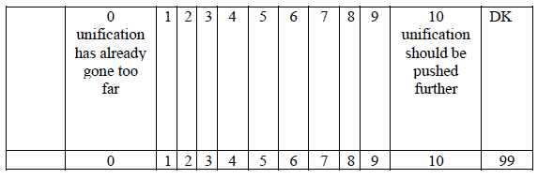
Data: European Election Study
Today mostly we will work with the following variable:
Q23 – European Integration
“Some say European unification should be pushed further. Others say it already has gone too far. What is your opinion? Please indicate your views using a scale from 0 to 10, where 0 means unification ‘has already gone too far’ and 10 means it ‘should be pushed further’. What number on this scale best describes you position?”

Slide 18






R packages
Now, we need to introduce some packages that will make your life much easier and are mostly part of the tidyverse.
Click on the icons!
haven
To load multiple types of datasets
dplyr a grammar of data manipulation
magrittr
famous for the pipe operator seen before
tidyr The goal is to help you create tidy data.
here extremely useful for avoiding to hard code every time the path to your files!
ggplot2 is a system for declaratively creating graphics, based on The Grammar of Graphics.

Slide 19
R packages
We will go through the packages during our hands-on sessions… but the tidyr package description gives you some indications that, in my opinion, are always useful:
The goal of tidyr is to help you create tidy data.
Tidy data is data where:
Each variable is a column
Each observation is a row
Each value is a cell
city | year | gdpchange
South Park | 2001 | -0.5451864
Springfield | 2001 | 1.4891976
South Park | 2002 | 1.4370989
Springfield | 2002 | 1.4935178
South Park | 2003 | 2.4436615
Springfield | 2003 | 1.5612424
South Park | 2004 | -0.9620170
Springfield | 2004 | -0.0697980
South Park | 2005 | 1.6643350
Springfield | 2005 | 1.0570046
Tidy dataset
Not tidy dataset
city | 2001 | 2002 | 2003 | 2004 | 2005
South Park | -0.5451864 | 1.437099 | 2.443662 | -0.962017 | 1.664335
Springfield | 1.4891976 | 1.493518 | 1.561242 | -0.069798 | 1.057005

Slide 20
Let‘s go through the script…
Now let's explore the data in R...
Admin/Setup – install and load packages, and options of the session, and environment cleaning
Tab with the functions used in the session
Tab for data loading
Tab for data wrangling
Tab for the analysis
Tab for visualizations/tables
Tab for exporting the output datasets
Follow me on the script:
​~/scripts/class4/class4_ees.R​
If you want to modify the code, CREATE A COPY!
Like “class4_ees_copy.R”

Slide 21
Focus: merging data
respid | serial | hCountry | countrycode | region
7762 | 100007762 | 1 | 1040 | 108
7801 | 100007801 | 1 | 1040 | 108
7904 | 100007904 | 1 | 1040 | 102
9223 | 100009223 | 1 | 1040 | 109
9338 | 100009338 | 1 | 1040 | 102
99 | 100009348 | 1 | 1040 | 108
9672 | 100009672 | 1 | 1040 | 106
9753 | 100009753 | 1 | 1040 | 106
9989 | 100009989 | 1 | 1040 | 101
10559 | 100010559 | 1 | 1040 | 104
10722 | 100010722 | 1 | 1040 | 101
countrycode | countryname
1040 | Austria
1056 | Belgium
1110 | Bulgaria
1191 | Croatia

Slide 22
Focus: merging data
respid | serial | hCountry | countrycode | region | countryname
7762 | 100007762 | 1 | 1040 | 108 | Austria
7801 | 100007801 | 1 | 1040 | 108 | Austria
7904 | 100007904 | 1 | 1040 | 102 | Austria
9223 | 100009223 | 1 | 1040 | 109 | Austria
9338 | 100009338 | 1 | 1040 | 102 | Austria
99 | 100009348 | 1 | 1040 | 108 | Austria
9672 | 100009672 | 1 | 1040 | 106 | Austria
9753 | 100009753 | 1 | 1040 | 106 | Austria
9989 | 100009989 | 1 | 1040 | 101 | Austria
10559 | 100010559 | 1 | 1040 | 104 | Austria
10722 | 100010722 | 1 | 1040 | 101 | Austria
countrycode | countryname
1040 | Austria
1056 | Belgium
1110 | Bulgaria
1191 | Croatia

Slide 23
Hands-on practice

Slide 24
Now it's your turn....
What you need to do:
Filter the data by country (select one)
Select one IV
Get some descriptive stats
Check differences across groups
Create a correlation plot with another continuous variable – e.g., left-right and redistribution
The parts of the script:
Admin/Setup
Tab with the functions used in the session
Tab for data loading
Tab for data wrangling
Tab for the analysis
Tab for visualizations/tables
Tab for exporting the output datasets
Rules:
DIY: Do it by yourself
KIS: Keep it simple
DRY: Don’t repeat yourself
Write comments
Use Rstudio tabs
Alt+O : Fold all the tabs in the script
Shift+Alt+O: Unfold all the tabs
Alt+L: Fold only the current tab
Shift+Alt+L: Unfold only the current tab
Other useful shortcuts:
Ctrl+C: mute a chunk of code with '#'
Alt+-: assignment operator, '<-'
Check also other shortcuts for Rstudio

Slide 25
Assignments

Slide 26
Assignment #1
Come up with some “expectations” about the relationship of interest
Start to thing whether your DV is affected also by other variables
Your model
N.B.: This is not necessarily the one you’ll develop in you term paper… so no worries, but come up with something plausible
Confounder
Independent Variable
Dependent Variable

Slide 27
Assignment #2
Keep on going with the code
I’ll ask you to upload it before Friday ☺

Slide 28
Assignment #2
What you need to do:
Filter the data by country (select one)
Select one IV
Get some descriptive stats
Check differences across groups
Create a correlation plot with another continuous variable – e.g., left-right and redistribution
The parts of the script:
Admin/Setup
Tab with the functions used in the session
Tab for data loading
Tab for data wrangling
Tab for the analysis
Tab for visualizations/tables
Tab for exporting the output datasets
Rules:
DIY: Do it by yourself
KIS: Keep it simple
DRY: Don’t repeat yourself
Write comments
Use Rstudio tabs
Alt+O : Fold all the tabs in the script
Shift+Alt+O: Unfold all the tabs
Alt+L: Fold only the current tab
Shift+Alt+L: Unfold only the current tab
Other useful shortcuts:
Ctrl+C: mute a chunk of code with '#'
Alt+-: assignment operator, '<-'
Check also other shortcuts for Rstudio

Slide 29
Thank you for your attention!

